Slide 1


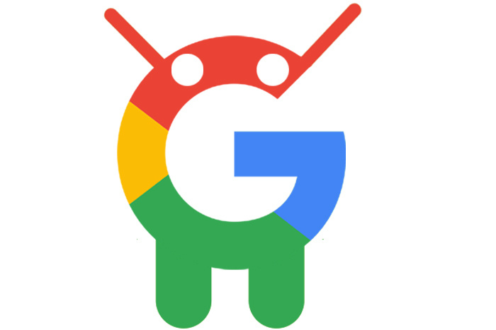
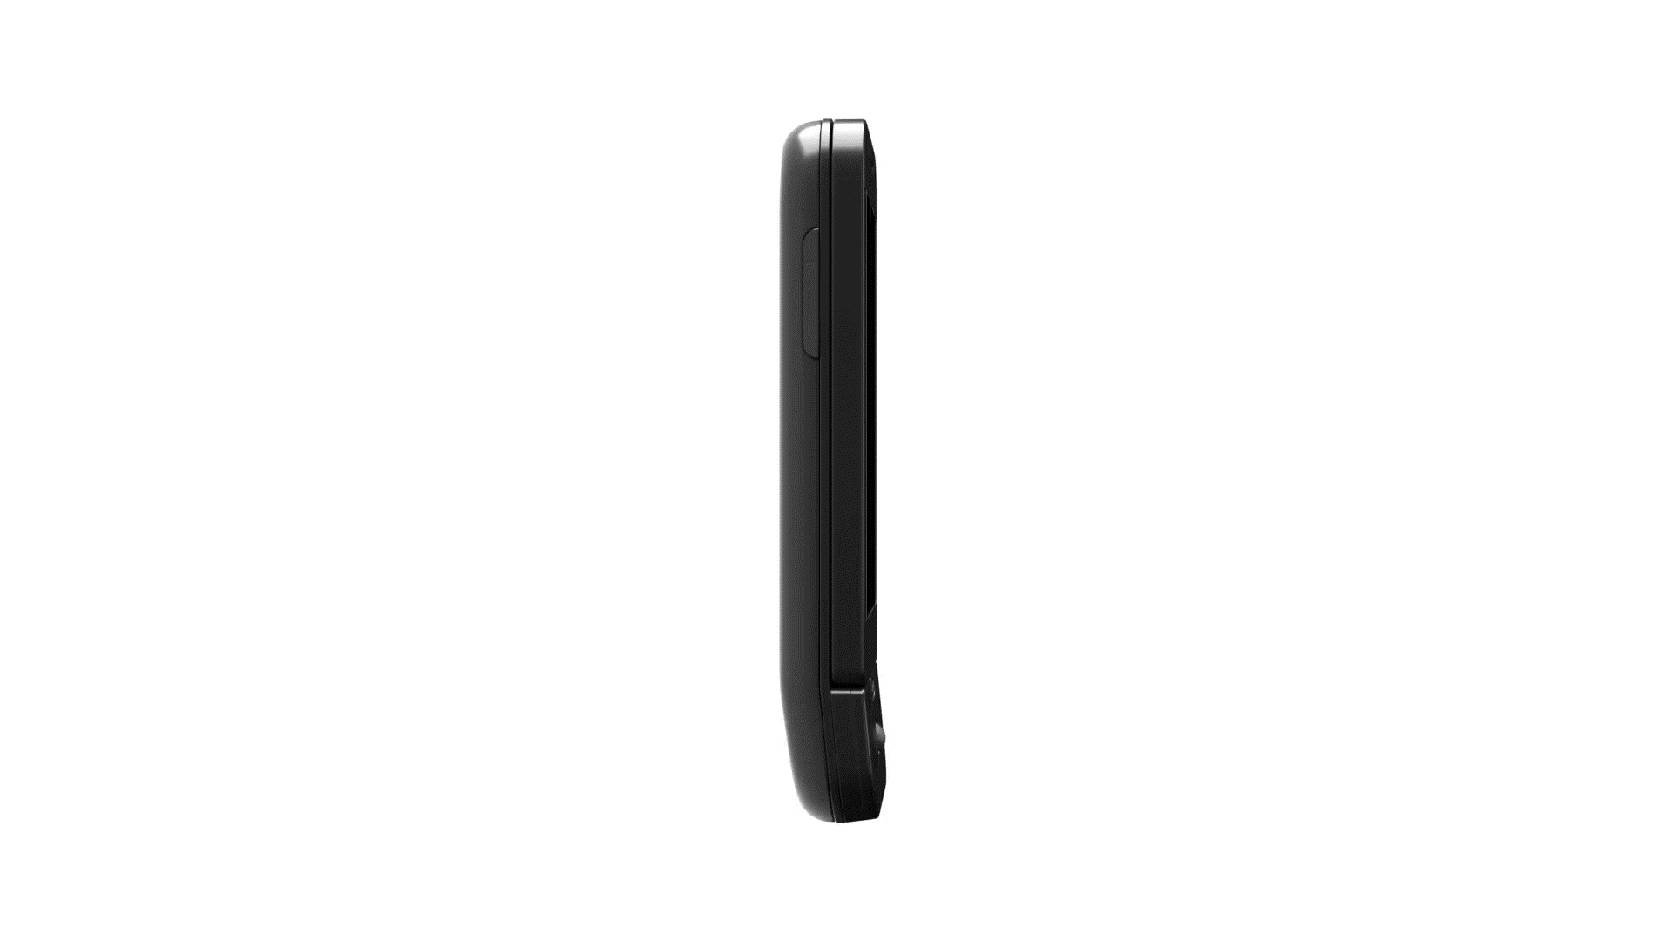

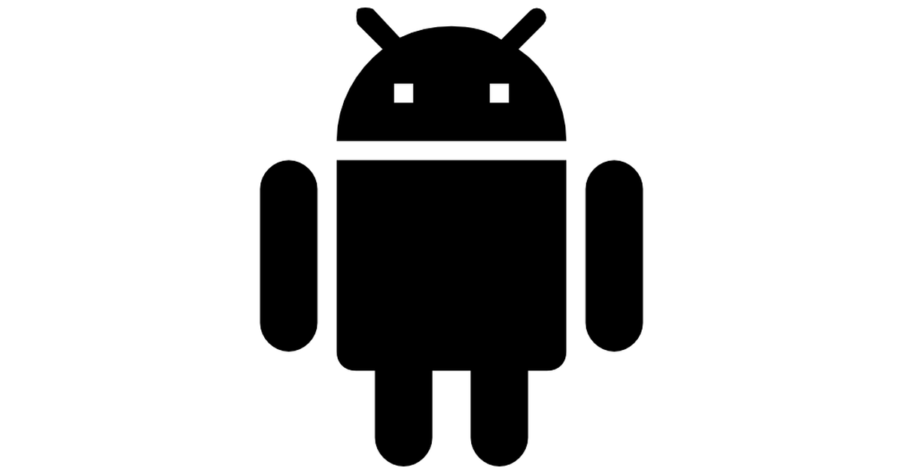
ANDROID
ANDROID OS
An open source operating system for phones and more..

Slide 2
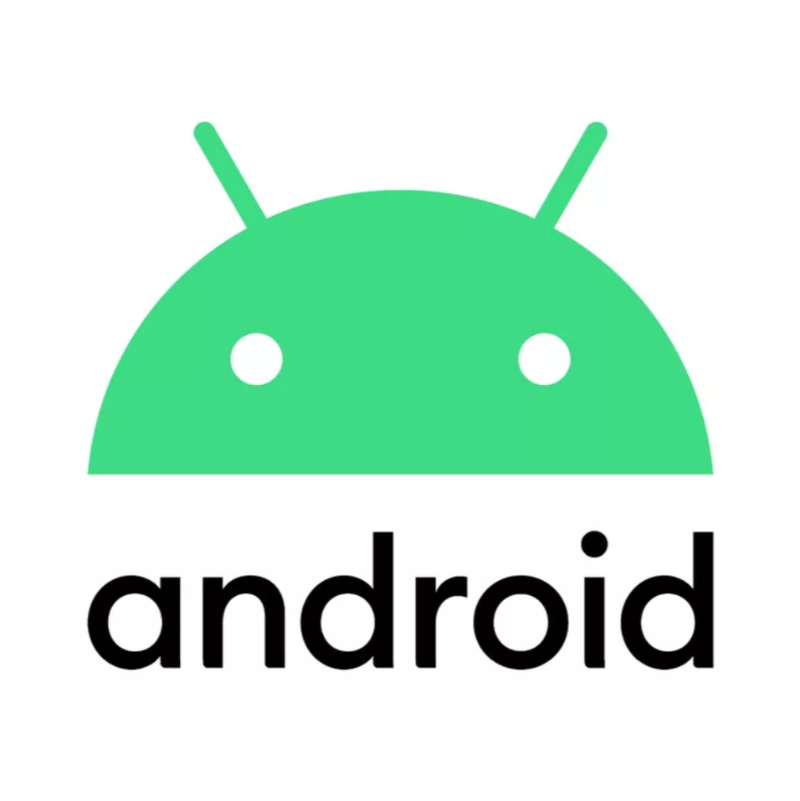
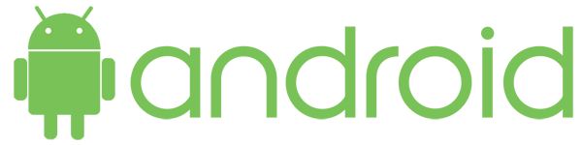
By - SHIVAm SHARMA KONARK SHARMA JITIN KR SINGH VEDANGI AGGARWAL
CSE – G , IInd Year IBM, Sharda University

Slide 3
INTRODUCTION
Android is a mobile operating system based on a modified version of the Linux kernel and other open source software, designed primarily for touchscreen mobile devices such as smartphones and tablets.
Android is Linux based operating system for mobile devices.
The android is an open source operating system.
There are more than 4,00,000 apps in android market.

Slide 4
Origin of android
Android was purchased by the GOOGLE in AUGUST, 2005 for $50 million.
The open handset alliance, a group of several companies was formed -5 November 2007. This group of companies are allowed to use source code of Android and develop applications.
Android beta released-12 November 2007.

Slide 5
FEATURES OF ANDROID
Android can run multiple apps at the same time
Also support optimized graphics VGA, 2D graphics and 3D graphics.
Android has better app market.
Android lets you change your setting faster.
It gives you more options to fit your budget
Android also support java applications

Slide 6
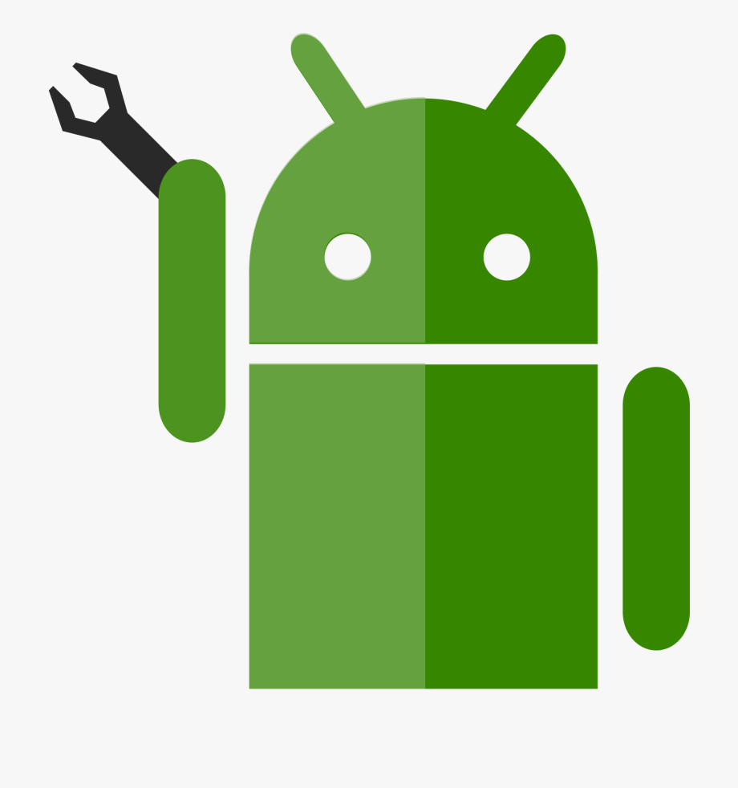
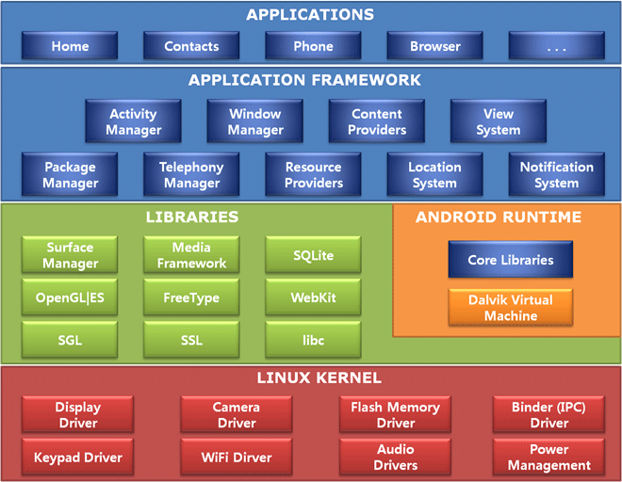
SYSTEM ARCHITECTURE
The Android software stack generally consists of a Linux kernel and a collection of C/C++ libraries that is exposed through an application framework that provides services, and management of the applications and run time.

Slide 7
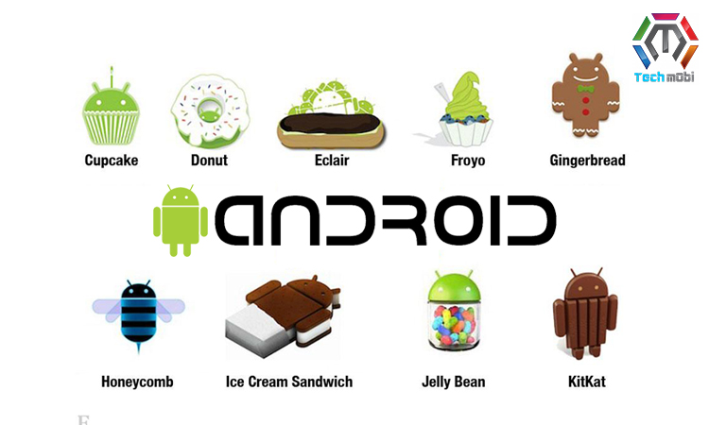
VERSIONS
And many more..

Slide 8
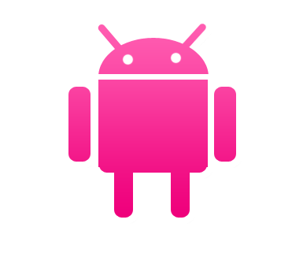
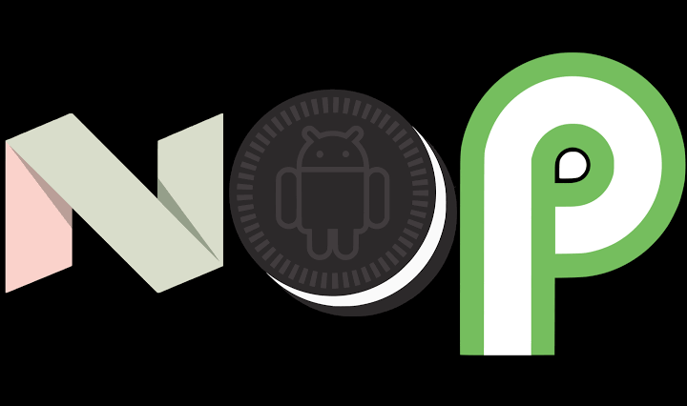
WHAT MAKES AN ANDROID SPECIAL?
Open source – Free development platform.
Built in components can be improved.
Built in services like GPS,SQL Database, browser and maps.
Management of process life cycle.
High quality graphics and sound.
Portability across current and future hardware.
Component-based architecture and reusable, replaceable modules.

Slide 9
Comparison
ANDROID
iOS
We can set any app as a default on android
Android just drag and drop for syncing by using USB cable on computer
While Google charges for Android developer only $5
Android OS have flash support
On Android , on which you are notified of an email as soon as it arrive
It is impossible on iPhone
Have to click manually
iPhone syncing only with iTunes
Apple charges for the App Developers $100
While the iPhone only has html5 support
The email system on the iPhone is horrible

Slide 10


I/O Scheduler
what is i/o scheduler?
Input/output (I/O) scheduling is a term used to describe the method computer operating systems decide the order that block I/O operations will be submitted to storage volumes. I/O Scheduling is sometimes called 'disk scheduling’.
there are many types of I/o schedulers available on android:
CFQ
Deadline
VR
Noop
BFQ
FIOPS
SIO (Simple)
ROW
ZEN
SIOplus
FIFO
Tripndroid
Test
Maple

Slide 11

Recommended I/O Scheduler’s :
For everyday usage: - ZEN (First choice) - ROW (Second choice) - SIO (Third choice) - Noop - CFQ - Deadline For battery life: - Noop (First choice) - FIOPS (Second choice) - SIO (Third choice) - ROW (Forth choice) For gaming: - Deadline (First choice) - ZEN (Second choice) - ROW (Third choice) - CFQ
For performance(Benchmarking): - FIOPS (First choice) - Deadline (Second choice) - Noop - ROW For heavy multitasking: - BFQ (First choice) - CFQ (Second choice) - Deadline (Third choice)

Slide 12
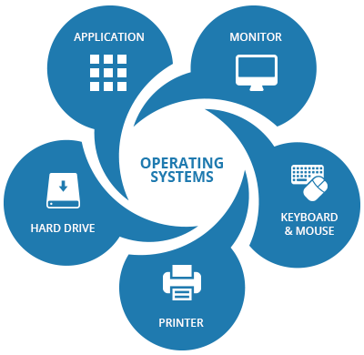
Scheduling algorithm’s
A Process Scheduler schedules different processes to be assigned to the CPU based on particular scheduling algorithms. There are six popular process scheduling algorithms which we are going to discuss :
First-Come, First-Served (FCFS) Scheduling
Shortest-Job-Next (SJN) Scheduling
Priority Scheduling
Shortest Remaining Time
Round Robin(RR) Scheduling
Multiple-Level Queues Scheduling
These algorithms are either non-preemptive or preemptive. Non-preemptive algorithms are designed so that once a process enters the running state, it cannot be preempted until it completes its allotted time, whereas the preemptive scheduling is based on priority where a scheduler may preempt a low priority running process anytime when a high priority process enters into a ready state.

Slide 13

Disk scheduling Algorithm’s
Disk scheduling algorithms, schedule the order of disk I/Os to improve performance.
There are 6 disk scheduling algorithms:
FCFS Scheduling
SSTF Scheduling
SCAN Scheduling
C-SCAN Scheduling
LOOK Scheduling
C-LOOK Scheduling

Slide 14
Android Memory Management
Android uses paging and mmap instead of providing swap space, which means any memory your application touches cannot be paged out unless you release all references.
The Dalvik* Virtual Machine’s heap size for application processes is limited. Applications start up with 2 MB, and the maximum allocation, marked as “largeHeap,” is limited to 36 MB
Android stores background application processes in a LRU cache. When the system runs low on memory, it will kill processes according to the LRU strategy.
If you need your app to live longer in the background, de-allocate unnecessary memory before moving to the background and the Android system will less likely generates error message or even terminates the app.

Slide 15
DDMS
Android studio includes a debugging tool called the Dalvik Debug Monitor Service (DDMS)
DDMS provides services like screen capture on the device, threading, heap information on the device, logcat, processes, incoming calls, SMS checking, location, data spoofing, and many other things related to testing your Android application.
Garbage collection
A managed memory environment, like the ART or Dalvik virtual machine, keeps track of each memory allocation. Once it determines that a piece of memory is no longer being used by the program, it frees it back to the heap, without any intervention from the programmer.
The mechanism for reclaiming unused memory within a managed memory environment is known as garbage collection.

Slide 16
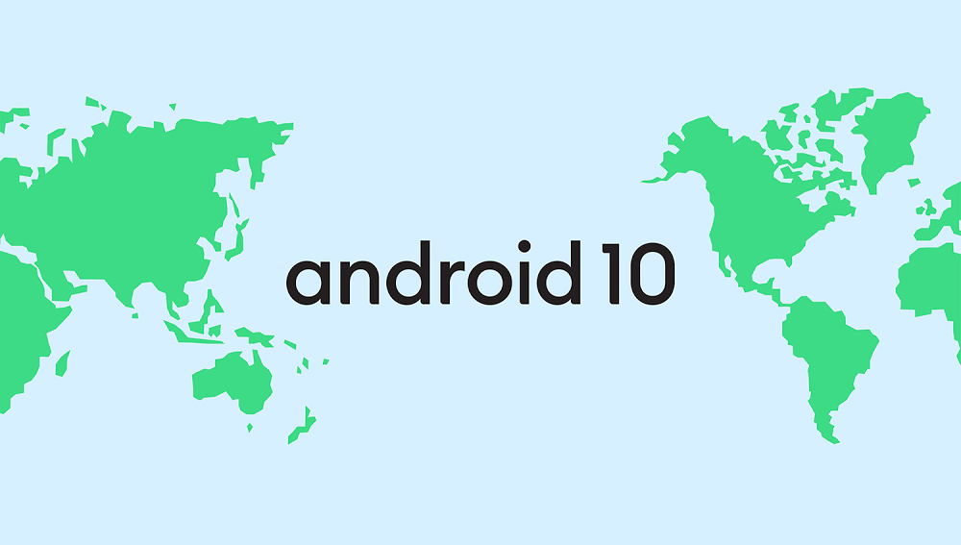
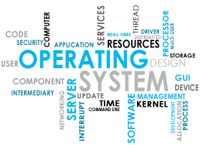
THANK YOU

